Slide 1

DEPARTMENT OF COMPUTER SCIENCE AND ENGINEERING
CVR COLLEGE OF ENGINEERING
(Accredited by NBA, AICTE & Autonomous and Affiliated to JNTUH)
CONVERTING TYPED OR HANDWRITTEN DOCUMENTS, SCANNED OR PHOTO IMAGES TO LEGIBLE TEXT.
Student Details
G.Hari Priya : 17B81A0565
CH.Indupriya : 17B81A0573
K.Kalyan : 17B81A0585
Supervisor
Dr.R.K.Selvakumar,
Professor/CSE.

Slide 2
PROBLEM STATEMENT
The aim of this project is to develop a Optical Capture Recognition Interface (OCR). Scanned text documents, pictures stored in desktops having windows as operating system, are the main focus of this application. Using this application Critical information is extracted, digitalized and stored in database in a structured manner. Hence, this proposed system mainly focuses on retrieval of information from PAN cards, and then digitalize the significant information.
.

Slide 3
PROPOSED SYSTEM
We propose Zone Optical Character Recognition Interface (ZOCRI) . The existing systems implement OCR, ICR, ZOCR for any type of documents or images but our application outstands by considering only documents related to PAN CARD and by extracting only critical information rather than overloading database with unnecessary data. This technology is very useful since it saves time without the need of retyping the document. It can perform the action in few minutes.

Slide 4
TECHNOLOGY STACK
Operating System : | Windows
Language : | Python 3.x
Libraries : | argparse cv2 csv ftfy io json numpy os PIL Pytesseract sys
Software(OCR Engine) : | Tesseract

Slide 5
PHASES OF DEVELOPMENT
1.PREPROCESS PHASE:
a . BINARIZATION
b . NOISE REDUCTION
c . SKEW CORRECTION
d . THRESHOLDING
2.MORPHOLOGY:
a . DILATE/ERODE
b . RESTRUCTURING
3.SEGMENTATION PHASE
4.EXTRACTION OF CHARACTERS
5.FILTERING THE DATA
6.STORING IN JSON AND CSV

Slide 6
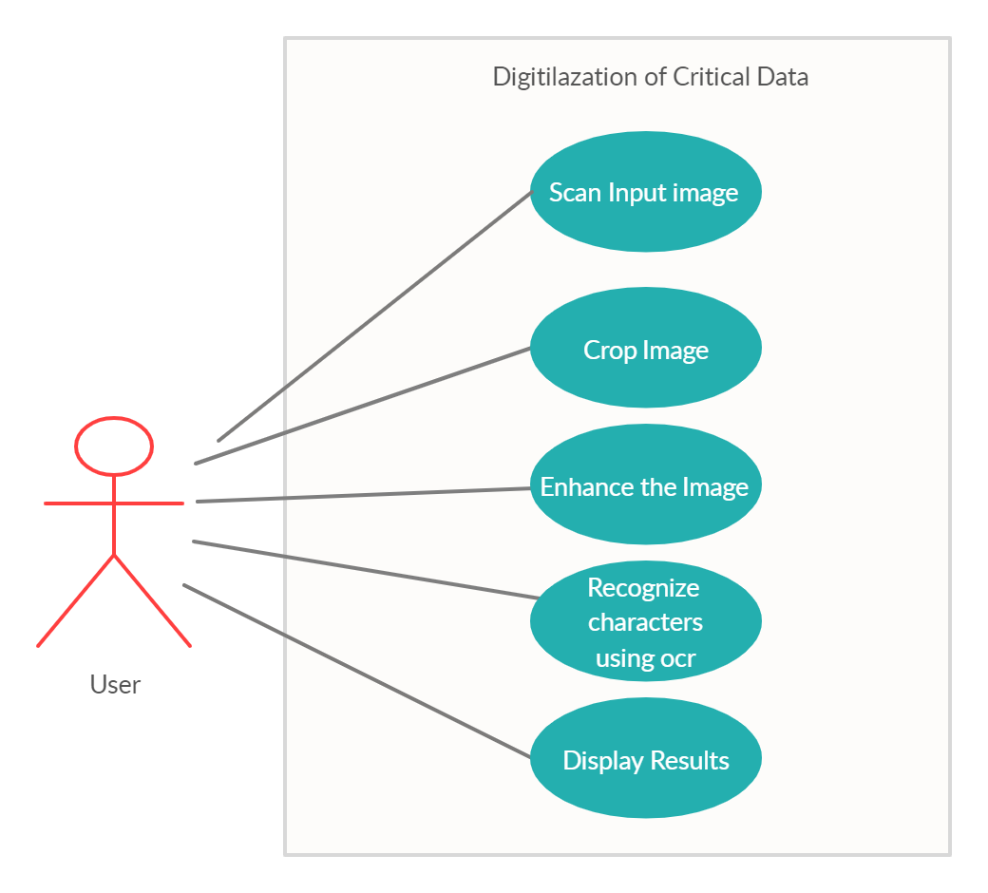
USE CASE DIAGRAM
Fig 1.USE CASE DIAGRAM

Slide 7
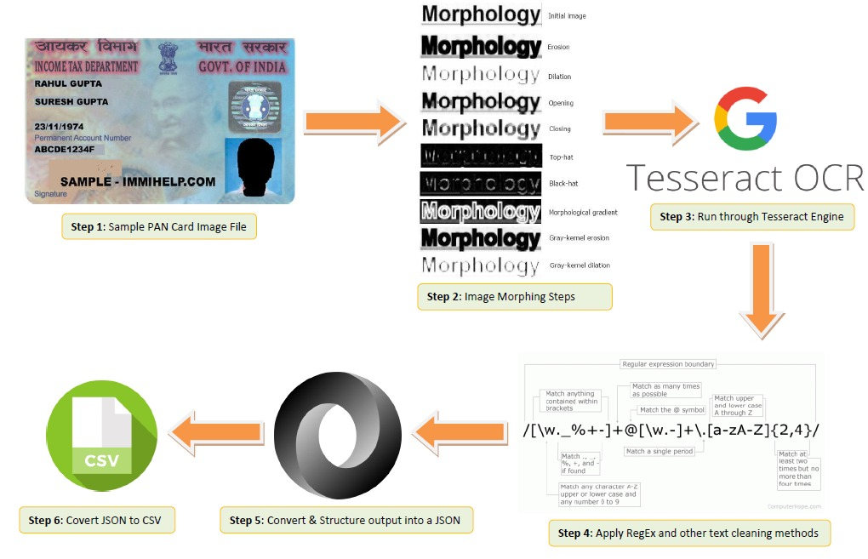
ARCHITECTURE DIAGRAM
Fig 2.ARCHITECTURE DIAGRAM

Slide 8
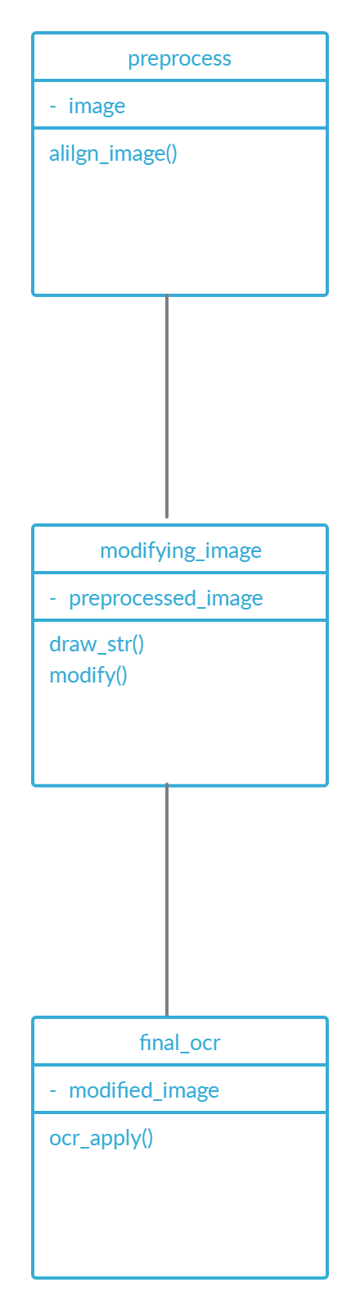
CLASS DIAGRAM
Fig 3.CLASS DIAGRAM

Slide 9
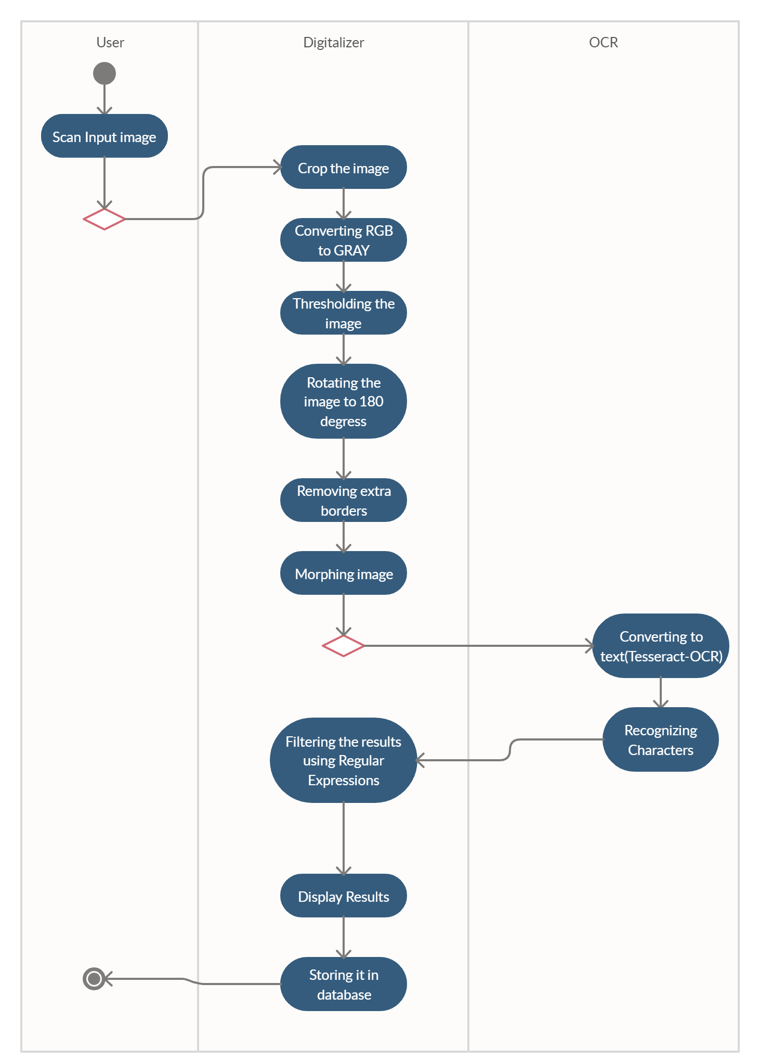
ACTIVITY DIAGRAM
Fig 4.ACTIVITY DIAGRAM

Slide 10
CONTRIBUTION OF TEAM MEMBER
17B81A0565
Research on skewing and affine transformation.
Identifying the correct orientation of images and adjusting the angle of image.
Implementation of preprocessing for noise reduction.
Implementation of our own ocr model for obtaining better accuracy.

Slide 11
CONTRIBUTION OF TEAM MEMBER
17B81A0573
Research on morphological operations and restructuring.
Identifying the suitable morphological operation for image enhancement to achieve accurate results.
Implementation of appropriate operation , structure for segmentation.
Implementation of our own ocr model for obtaining better accuracy.

Slide 12
CONTRIBUTION OF TEAM MEMBER
17B81A0585
Research on thresholding , interpolation , feature extraction.
Identifying the suitable threshold/interpolation method for accurate
results.
Cleaning and filtering the extracted characters.
Implementation of our own ocr model for obtaining better accuracy.

Slide 13
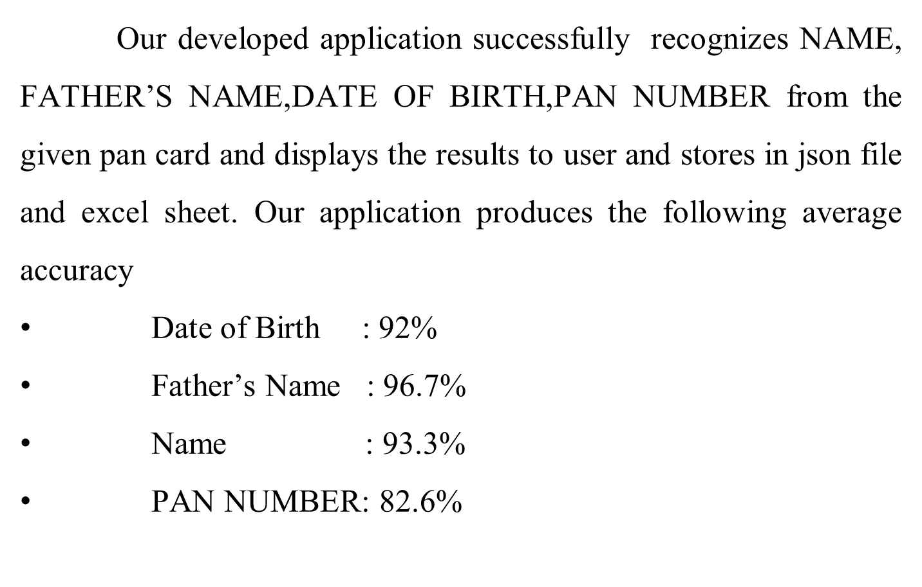
RESULTS AND DISCUSSIONS

Slide 14
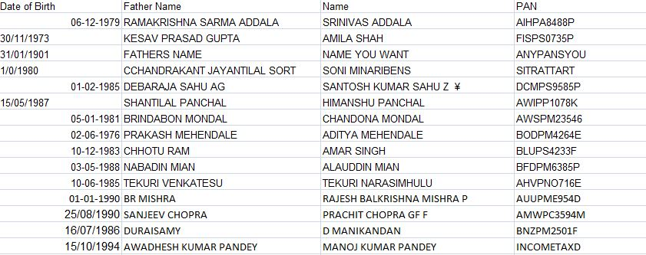
RESULTS AND DISCUSSIONS
Fig 5.VALUES STORED IN EXCEL SHEET

Slide 15
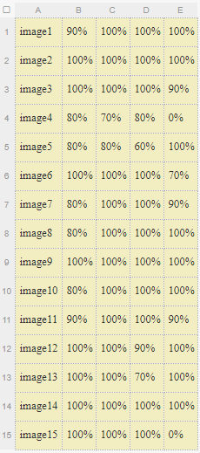
RESULTS AND DISCUSSIONS
Fig 6.ACCURACY TABLE
COLUMN A-IMAGE
COLUMN B –DATE OF BIRTH(ACCURACY %)
COLUMN C-FATHER’S NAME (ACCURACY%)
COLUMN D-NAME (ACCURACY %)
COLUMN E-PAN NUMBER (ACCURACY %)

Slide 16
CONCLUSION AND FUTURE ENHANCEMENT
Numerous algorithms, methods and techniques have been proposed to optical character recognition in scene imagery, yet there are not enough literature surveys in this field. In this project,we have attempted to obtain maximum accuracy using pre-defined models and techniques. As a future work, we are planning to incorporate mobile devices with OCR in one CR system. An automated book reader or a receipt tracker constitutes some of our future OCR based applications.

Slide 17
THANK YOU

